Slide 1
CHAPTER 10
Sockets
Prof. Ju-Hong Lee, Data Science Lab, Inha Univ

Slide 2
Introduction

Slide 3
Internet model (TCP/IP protocol suite)(1/2)
User Process
User Process
User Process
Application
Socket API
TCP
UDP
Transport
process-to-process
IP
Network
host-to-host
node-to-node
Hardware Interface
Link

Slide 4
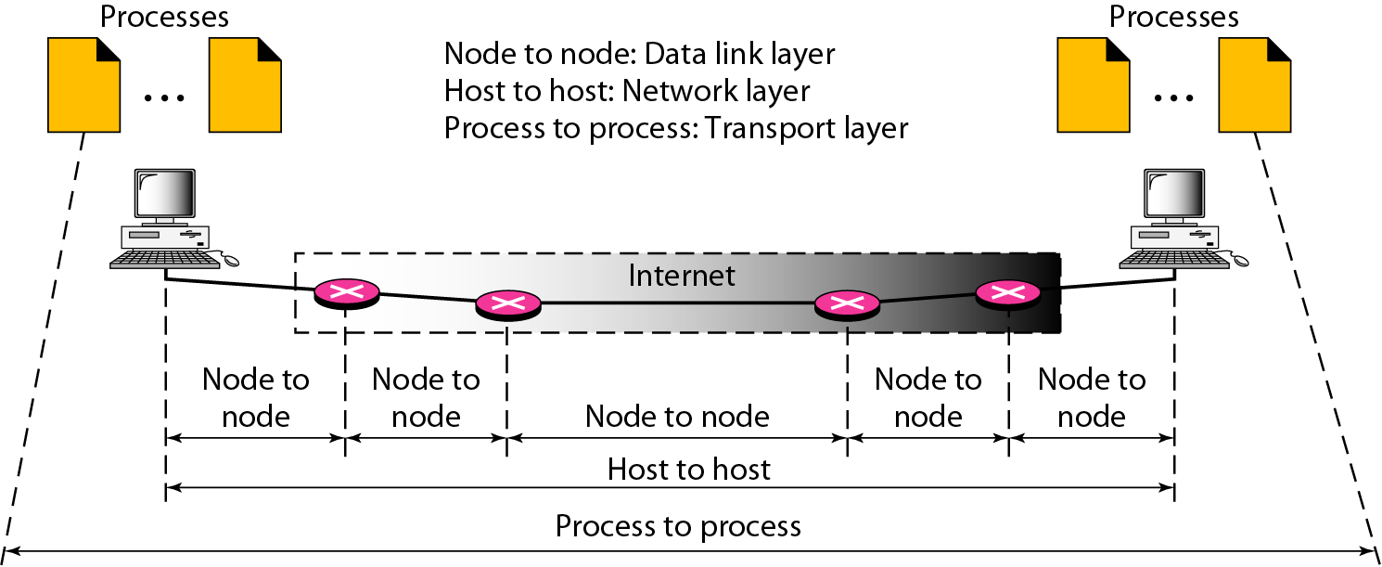
Internet model (TCP/IP protocol suite)(2/2)

Slide 5
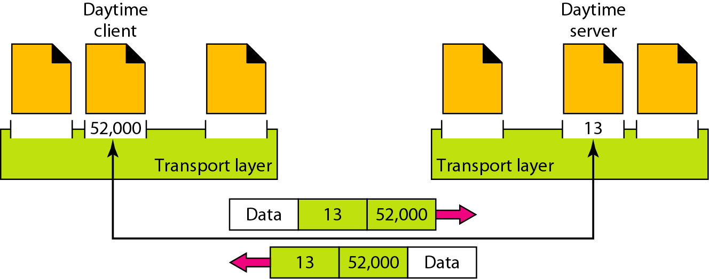
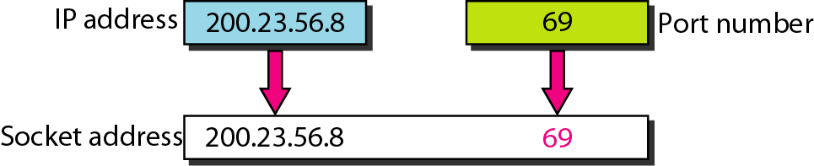
Port numbers

Slide 6
UNIX Networking
UNIX Networking
BSD (Berkeley)
in 1982 (4.1cBSD UNIX)
socket interface
System V(AT&T)
in 1986
Transport Level Interface (TLI)
In 2001, POSIX incorporated 4.3BSD sockets and an alternative, XTI.
This lecture focuses on socket implementations.

Slide 7
Sockets
A socket is an abstraction of a communication endpoint.
A way to speak to other programs using standard Unix file descriptors.
“Everything in Unix is a file”
A file descriptor is simply an integer associated with an open file. But (and here's the catch), that file can be a network connection, a FIFO, a pipe, a terminal, a real on-the-disk file, or just about anything else.
So when you want to communicate with another program over the Internet you're gonna do it through a file descriptor, you'd better believe it.

Slide 8
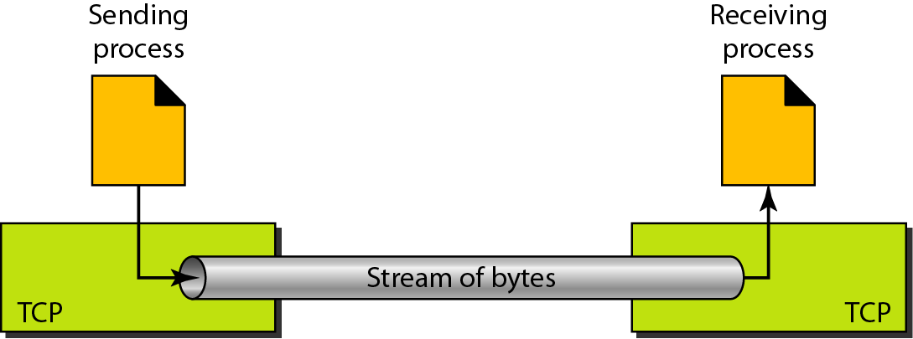
Two Types of Internet Sockets
Datagram sockets, which use UDP
connectionless protocol
no flow and error control (unreliable)
small message
Multicast and broadcast
Stream Sockets, which use TCP
connection-oriented protocol
uses flow and error control mechanisms (reliable)

Slide 9
서버 와 클라이언트 소켓 구현의 이해 TCP

Slide 10
서버 소켓 구현의 이해 (1)
Telephone
Server Socket
전화기 구입
전화번호 할당
케이블에 연결
수화기 든다!
소켓 생성
IP 주소 할당.
연결 요청 대기 상태
연결 수락!

Slide 11
서버 소켓 구현의 이해 (2)
순서 1. 전화를 걸고 싶은데 무엇이 필요합니까?
- 소켓의 생성을 요구한다.
순서 2. 당신의 전화번호는 어떻게 되나요?
- 주소의 할당을 요구한다(IP 주소, Port 정보).
#include <sys/socket.h>
int socket(int domain, int type, int protocol);
Returns: file (socket) descriptor if OK, -1 on error
#include <sys/socket.h>
int bind(int sockfd, const struct sockaddr *addr, socklen_t len);
Returns: 0 if OK, -1 on error

Slide 12
서버 소켓 구현의 이해 (3)
순서 3. 전화기를 연결 하시겠습니까?
- 연결 요청 대기 상태로의 진입.
순서 4. 전화벨이 울립니다. 어서 전화 받으세요!!!
- 연결 요청 수락.
#include <sys/socket.h>
int listen(int sockfd, int backlog);
Returns: 0 if OK, -1 on error
#include <sys/socket.h>
int accept(int sockfd, struct sockaddr *restrict addr, socklen_t *restrict len);
Returns: file (socket) descriptor if OK, 1 on error

Slide 13
클라이언트 소켓 구현의 이해(1)
순서 1. 전화를 걸고 싶은데 무엇이 필요합니까?
- 소켓의 생성
순서 2. 전화를 걸어요
- 연결 요청
- 주소할당과정인 bind()가 자동으로 됨.
#include <sys/socket.h>
int connect(int sockfd,const struct sockaddr *addr,socklen_t len);
Returns: 0 if OK, -1 on error

Slide 14
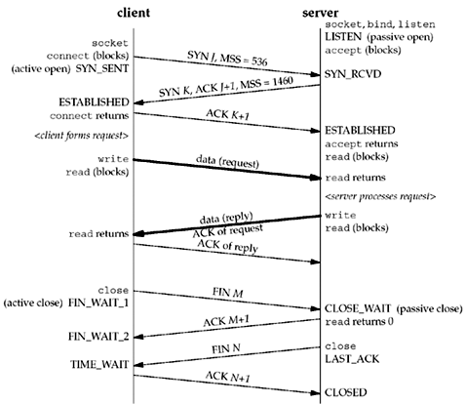
Server
socket()
bind()
Client
listen()
socket()
Block until
connect
accept()
connect()
TCP three-way handshaking
send()
Data (request)
recv()
Data (reply)
send()
recv()
close()
recv()
close()
Notes:
Block until the client request the connection.

Slide 15
Server
#include <stdio.h> #include <stdlib.h> #include <string.h> #include <unistd.h> #include <arpa/inet.h> #include <sys/types.h> #include<sys/socket.h> int main(int argc, char **argv){ int serv_sock, clnt_sock; struct sockaddr_in serv_addr, clnt_addr;
int clnt_addr_size; char message[]="Hello World!\n"; if(argc!=2){ printf("Usage : %s <port>\n", argv[0]); exit(1); } serv_sock=socket(PF_INET, SOCK_STREAM, 0); /* 서버 소켓 생성 */ if(serv_sock == -1) error_handling("socket() error"); memset(&serv_addr, 0, sizeof(serv_addr)); serv_addr.sin_family=AF_INET; serv_addr.sin_addr.s_addr=htonl(INADDR_ANY); serv_addr.sin_port=htons(atoi(argv[1])); if( bind(serv_sock, (struct sockaddr*) &serv_addr, sizeof(serv_addr))==-1 ) error_handling("bind() error"); if( listen(serv_sock, 5)==-1 ) error_handling("listen() error"); clnt_addr_size=sizeof(clnt_addr); clnt_sock=accept(serv_sock, (struct sockaddr*)&clnt_addr,&clnt_addr_size); if(clnt_sock==-1) error_handling("accept() error"); write(clnt_sock, message, sizeof(message)); /* 데이터 전송 */ close(clnt_sock); /* 연결 종료 */ return 0; }

Slide 16
Client
#include <stdio.h> #include <stdlib.h> #include <string.h> #include <unistd.h> #include <arpa/inet.h> #include <sys/types.h> #include <sys/socket.h>
int main(int argc, char **argv){ int sock; struct sockaddr_in serv_addr; char message[30]; int str_len; if(argc!=3){ printf("Usage : %s <IP> <port>\n", argv[0]); exit(1); } sock=socket(PF_INET, SOCK_STREAM, 0); if(sock == -1) error_handling("socket() error"); memset(&serv_addr, 0, sizeof(serv_addr)); serv_addr.sin_family=AF_INET; serv_addr.sin_addr.s_addr=inet_addr(argv[1]); serv_addr.sin_port=htons(atoi(argv[2])); if(connect(sock, (struct sockaddr*)&serv_addr, sizeof(serv_addr))==-1) error_handling("connect() error!"); str_len=read(sock, message, sizeof(message)-1); /* 데이터 수신 */ if(str_len==-1) error_handling("read() error!"); message[str_len]=0; printf("Message from server : %s \n", message); close(sock); /* 연결 종료 */ return 0; }

Slide 17
서버 와 클라이언트 소켓 구현의 이해 UDP

Slide 18
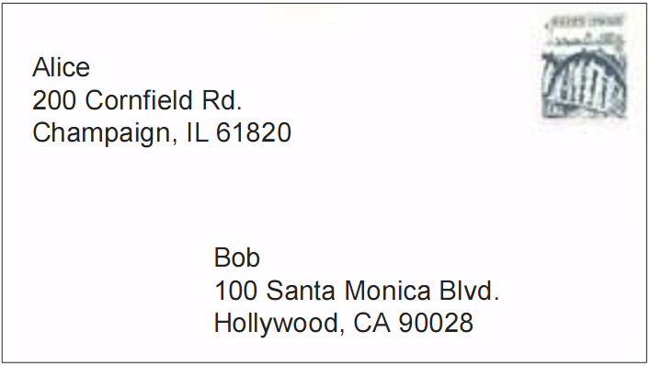

Slide 19
Client
Server
socket()
socket()
bind()
bind()
sendto()
Data (request)
recvfrom()
Block until
data from client
recvfrom()
Data (reply)
sendto()
Notes:
Block until data is received from the client

Slide 20
10.3 Addressing

Slide 21
Internet addressing
Hosts are mapped to a set of 32-bit IP addresses.
165.246.10.2
The set of IP addresses is mapped to a set of identifiers called Internet domain names.
165.246.10.2 is mapped to inha.ac.kr
#include <arpa/inet.h>
int inet_aton(const char *strptr, struct in_addr *addrptr); Returns: 1 if string was valid, 0 on error
in_addr_t inet_addr(const char *strptr); Returns: 32-bit binary network byte ordered IPv4 address; INADDR_NONE if error
char *inet_ntoa(struct in_addr inaddr); Returns: pointer to dotted-decimal string

Slide 22
Main Structure
struct sockaddr {
u_short sa_family;
char sa_data[14];
};
struct in_addr {
u_long s_addr;
};
struct sockaddr_in {
u_short sa_family;
u_short sin_port;
struct in_addr sin_addr;
char sin_zero[8];
};
Generic address
<sys/socket.h>
IP address
<netinet/in.h>
TCP/UDP address
(includes port #)
<netinet/in.h>

Slide 23
Byte Ordering
0x12345678
Big-Endian
Little-Endian
0x12
12 번지
0x78
0x34
13 번지
0x56
0x56
14 번지
0x34
0x78
15 번지
0x12

Slide 24
Confusing the byte ordering
0x34
0x12
Big-Endian
Little-Endian
0x12
12 번지
0x12
0x34
0x34
13 번지
0x1234
0x3412

Slide 25
Network byte order
The TCP/IP protocol suite uses big-endian byte order.
so applications sometimes need to translate them between the processor 's byte order and the network byte order.
0x34
0x12
Big-Endian
0x12
0x34
Little-Endian
0x12
12 번지
0x34
0x34
0x12
13 번지
0x1234
0x1234

Slide 26
The byte order functions
#include <arpa/inet.h>
uint32_t htonl(uint32_t hostint32);
Returns: 32-bit integer in network byte order
uint16_t htons(uint16_t hostint16);
Returns: 16-bit integer in network byte order
uint32_t ntohl(uint32_t netint32);
Returns: 32-bit integer in host byte order
uint16_t ntohs(uint16_t netint16);
Returns: 16-bit integer in host byte order

Slide 27
10.4 Socket interface

Slide 28
The socket(2) system call
#include <sys/socket.h>
int socket(int domain, int type, int protocol);
Returns: file (socket) descriptor if OK, -1 on error
socket() returns a socket descriptor, an int similar to a file descriptor.
Domain | Description
AF_INET | IPv4 Internet domain
AF_INET6 | IPv6 Internet domain
AF_UNIX | UNIX domain
AF_UNSPEC | unspecified
Protocol
IPPROTO_TCP
IPPROTO_UDP
Type(socket type) | Description
SOCK_DGRAM | fixed-length, connectionless, unreliable messages
SOCK_RAW | datagram interface to IP (optional in POSIX.1)
SOCK_SEQPACKET | fixed-length, sequenced, reliable, connection-oriented messages
SOCK_STREAM | sequenced, reliable, bidirectional, connection-oriented byte streams
Notes:
역사적으로 원래 의도는 하나의 프로토콜 패밀리가 여러 개의 어드레스 패밀리들이 지원되도록 하는 것이 의도였음.
PF는 소켓을 생성하기 위해 사용되고, AF는 socket address structure들을 설정하는데 사용.
그러나 현재 프로토콜 패밀리는 여러 개의 어드레스 패밀리를 전혀 지원하고 있지 않는다. <sys/socket.h>에 PF와 AF는 동일하게 설정되어 있다.

Slide 29
Selecting the Protocol
Connection-Oriented vs Connectionless
Connection oriented (streams)
sd = socket(AF_INET, SOCK_STREAM, 0);
Connectionless (datagrams):
sd = socket(AF_INET, SOCK_DGRAM, 0);
For the internet (AF_INET) this corresponds to TCP and UDP respectively

Slide 30
10.5 Programming the connection oriented model

Slide 31
The bind(2) system call
#include <sys/socket.h>
int bind(int sockfd, const struct sockaddr *addr, socklen_t len);
Returns: 0 if OK, -1 on error
In the IPv4 Internet domain (AF_INET), a socket address is represented by a sockaddr_in structure
struct sockaddr { u_short sa_family; /* address family */ char sa_data[14]; /* variable-length address */ };
struct in_addr { u_long s_addr; /* IPv4 address */ };
struct sockaddr_in { u_short sin_family; /* address family */ u_short sin_port; /* port number */ struct in_addr sin_addr; /* IPv4 address , INADDR_ANY */ char sin_zero[8]; };

Slide 32
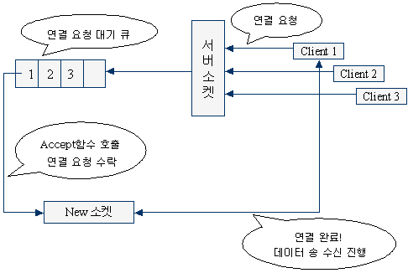
The listen(2) system call
#include <sys/socket.h>
int listen(int sockfd, int backlog);
Returns: 0 if OK, -1 on error
argument
backlog : server can queue up to backlog incoming connection requests

Slide 33
The accept(2) system call
#include <sys/socket.h>
int accept(int sockfd, struct sockaddr *restrict addr, socklen_t *restrict len);
Returns: file (socket) descriptor if OK, -1 on error
When the server receives a connect request from a client it has to create an entirely new socket to handle the specific communication.
first socket
for only establishing the connection.
second socket
for specific communication
argument
addr : NULL
len : NULL
because this is a connection oriented communication

Slide 34
example p.260 (Server process)
#include <ctype.h> #include <sys/types.h> #include <sys/socket.h> #include <netinet/in.h> #define SIZE sizeof (struct sockaddr_in) int newsockfd; main(){ int sockfd; struct sockaddr_in server = {AF_INET, 7000, INADDR_ANY); if ( (sockfd = socket (AF_INET, SOCK_STREAM, 0)) == -1){ perror ("socket call failed"); exit (1); }
if ( bind(sockfd, (struct sockaddr *)&server, SIZE) == -1){ perror ("bind call failed"); exit (1); }
if ( listen(sockfd, 5) == -1){ perror ("listen call failed"); exit (1);
}
for ( ; ;){
if ( (newsockfd = accept(sockfd, NULL, NULL)) == -1){ perror ("accept call failed"); continue; }
/* 연결을 처리할 자식을 하나 낳는다. 만일 자식이면 클라이언트와 정보를 보내고 받는다 */ }
}

Slide 35
The connect(2) system call
#include <sys/socket.h>
int connect(int sockfd, const struct sockaddr *addr, socklen_t len);
Returns: 0 if OK, -1 on error
argument
addr : sever address

Slide 36
example p.262 (Clinet process)
/* 클라이언트 프로세스 */ #include <ctype.h> #include <sys/types.h> #include <sys/socket.h> #include <netinet/in.h>
#define SIZE sizeof (struct sockaddr_in)
main(){ int sockfd; struct sockaddr_in server = {AF_INET, 7000};
/* 서버의 IP 주소를 변환하여 저장한다. */ server.sin_addr.s_addr = inet_addr ("206.45.10.2");
/* 트랜스포트 엔드 포인트를 구축한다. */ if ( (sockfd = socket (AF_INET, SOCK_STREAM, 0)) == -1){ perror ("socket call failed"); exit( 1); } /* 소켓을 서버의 주소에 연결한다. */
if ( ( connect (sockfd, (struct sockaddr *) &server, SIZE) == -1){ perror ("connect call failed"); exit (1); }
/* 서버와 정보를 보내고 받는다. */
}

Slide 37
Sending and receiving data
#include <sys/socket.h>
ssize_t recv(int sockfd, void *buf, size_t nbytes, int flags);
Returns: length of message in bytes, 0 if no messages are available and peer has done an orderly shutdown, or -1 on error
ssize_t send(int sockfd, const void *buf, size_t nbytes, int flags);
Returns: number of bytes sent if OK, -1 on error
flags == 0 → read(), write()
flag(recv) | Description
MSG_PEEK | Return packet contents without consuming packet
MSG_OOB | Retrieve out-of-band data if supported by protocol
MSG_WAITALL | Wait until all data is available (SOCK_STREAM only).
flag(send) | Description
MSG_DONTWAIT | Enable nonblocking operation (equivalent to using O_NONBLOCK).
MSG_OOB | Send out-of-band data if supported by protocol.
MSG_DONTROUTE | Don't route packet outside of local network.
MSG_EOR | This is the end of record if supported by protocol.

Slide 38
Closing the connection
It is very important to deal sensibly with unexpected death of the process at the other end of a socket
If a process attempts to write or send data to a socket which has become disconnected it will receive the SIGPIPE signal
If read or recv returns zero(0) this indicate end of file and therefore the connection

Slide 39
example p.265 (Server process) (1/2)
#include <ctype.h> #include <sys/types.h> #include <sys/socket.h> #include <netinet/in.h> #include <signal.h> #define SIZE sizeof (struct sockaddr_in) int newsockfd;
void catcher (int sig){ close (newsockfd); exit (0); } main(){ int sockfd; char c; struct sockaddr_in server = {AF_INET, 7000, INADDR_ANY}; static struct sigaction act; act.sa_handler = catcher; sigfillset (&(act.sa_mask)); sigaction (SIGPIPE, &act, NULL);
if ( (sockfd = socket(AF_INET, SOCK_STREAM, 0)) == -1){ perror ("socket call failed"); exit (1); }
if (bind (sockfd, (struct sockaddr *) &server, SIZE) == -1) { perror ("bind call failed"); exit (1); }
if ( listen(sockfd, 5) == -1 ){/* 들어오는 연결을 듣기 시작한다. */ perror ("listen call failed"); exit (1); }

Slide 40
example p.265 (Server process) (2/2)
for (;;){ if ( (newsockfd = accept (sockfd, NULL, NULL)) == -1){ perror ("accept call failed"); continue; }
/* 연결을 처리할 자식을 하나 낳는다. */ if ( fork() == 0){ while (recv (newsockfd, &c, 1, 0) > 0){ c = toupper(c); send (newsockfd, &c, 1, 0); }
close (newsockfd); exit (0); }
/* 부모는 newsockfd를 필요로 하지 않는다. */ close (newsockfd); }
}

Slide 41
example p.267 (Clinet process)
#include <ctype.h> #include <sys/types.h> #include <sys/socket.h> #include <netinet/in.h> #define SIZE sizeof (struct sockaddr_in) main(){ int sockfd; char c, rc; struct sockaddr_in server = {AF_INET, 7000}; server.sin_addr.s_addr = inet_addr("197.45.10.2"); if ( (sockfd = socket(AF_INET, SOCK_STREAM, 0)) == -1){ perror ("socket call failed"); exit (1); }
if ( connect(sockfd, (struct sockaddr *) &server, SIZE) == -1){ perror ("connect call failed"); exit (1); }
for (rc = '\n‘; ;){ if (rc == '\n') printf ("Input a lower case character\n"); c = getchar(); send (sockfd, &c, 1, 0); if (recv(sockfd, &rc, 1, 0)>0) printf ("%c", rc); else { printf ("server has died\n"); close (sockfd); exit (1); } } }

Slide 42
Example of Server Operation
Server
X
X
Server 1
Client 1
Server 2
Client 1

Slide 43
10.6 Programming the connectionless model

Slide 44
Sending and receiving messages
#include <sys/socket.h>
ssize_t recvfrom(int sockfd, void *restrict buf, size_t len, int flags,
struct sockaddr *restrict send_addr, socklen_t *restrict addrlen);
Returns: length of message in bytes, 0 if no messages are available and peer has done an orderly shutdown, or -1 on error
ssize_t sendto(int sockfd, const void *buf, size_t nbytes, int flags,
const struct sockaddr *dest_addr, socklen_t destlen);
Returns: number of bytes sent if OK, -1 on error
argument
send_addr : the address information of the machine which sent the message.
dest_addr : the address of the peer for the message to sent

Slide 45
example p.269(364) (Server process)
#include <ctype.h> #include <sys/types.h> #include <sys/socket.h> #include <netinet/in.h> #define SIZE sizeof (struct sockaddr_in) main(){ int sockfd; char c; struct sockaddr_in server = {AF_INET, 7000, INADDR_ANY}; struct sockaddr_in client; int client_len = SIZE;
if ( (sockfd = socket(AF_INET, SOCK_DGRAM, 0)) == -1){ perror ("socket call failed"); exit(1);
} if ( bind(sockfd, (struct sockaddr *) &server, SIZE)== -1){ perror ("bind call failed"); exit (1); }
for( ; ;){ if (recvfrom(sockfd, &c, 1, 0,&client, &client_len)== -1){ perror ("server: receiving"); continue; }
c = toupper(c); if ( sendto(sockfd, &c, 1, 0, &client, client_len) == -1){ perror ("server: sending"); continue; } } }

Slide 46
example p.270(365) (Client process)
#include <ctype.h> #include <sys/types.h> #include <sys/socket.h> #include <netinet/in.h> #define SIZE sizeof (struct sockaddr_in) main(){ int sockfd; char c; struct sockaddr_in client = {AF_INET, INADDR_ANY, INADDR_ANY}; struct sockaddr_in server = {AF_INET, 7000}; server.sin_addr.s_addr = inet_addr("197.45.10.2"); if ( (sockfd = socket(AF_INET, SOCK_DGRAM, 0)) == -1){ perror ("socket call failed"); exit (1); }
if ( bind(sockfd, (struct sockaddr *) &client, SIZE)== -1) { perror ("bind call failed"); exit (1);
}
while ( read(0, &c, 1) != 0){ if ( sendto (sockfd, &c, 1, 0, &server, SIZE) == -1){ perror ("client: sending"); continue; }
if (recv(sockfd, &c, 1, 0)== ―1){ perror ("client: receiving"); continue; } write (1, &c, 1); } }

